Slide 1

Stockly
What is the application
It is an iOS application for very small companies.
The company could have small inventory to manage such as an eBay or Amazon seller who buy and sell products but have a small stock to manage.
For such small company where do not require an external database.

Slide 2
Outline of the application
The owner will able to create a customizable store (inventory).
The owner will be able to add products, their images, type, sizes, values and quantity.
Products quantity updates as the owner deduct or adds items to the stock.
The app will be able to generate a report either weekly or monthly.
With the use of data (assuming the owner has at 3 months of data for the stocks) the app will be able to predict which items most likely to be ordered and which items are less likely to be order.

Slide 3
Outline of the application (continuing )
Notification
The app will send notification to the owner if any stock is getting too low which the user can set up.
Core Database
Core Database will be used for the inventory stocks.
Core Graphics
Core graphics will be used for the image management of the app.

Slide 4
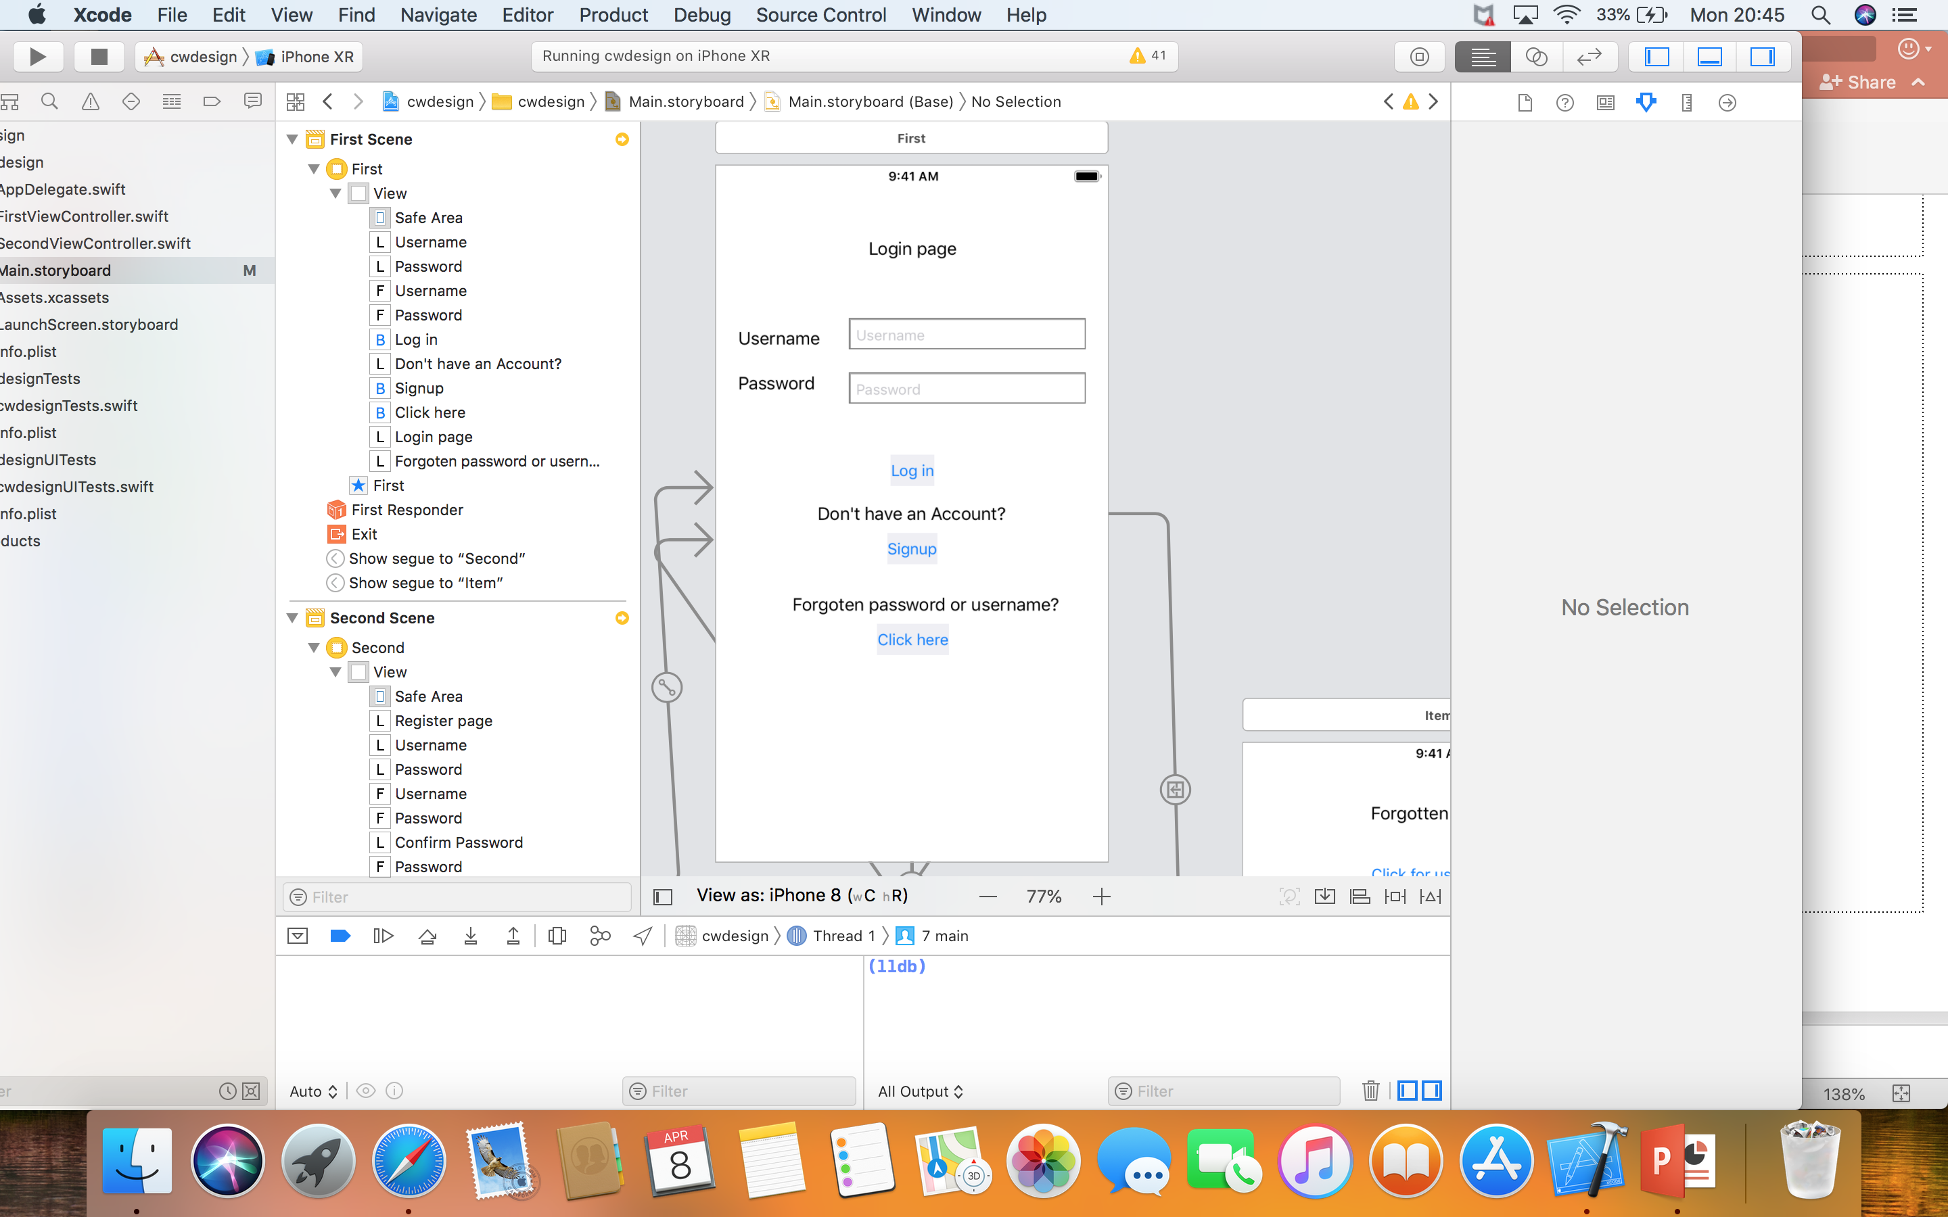
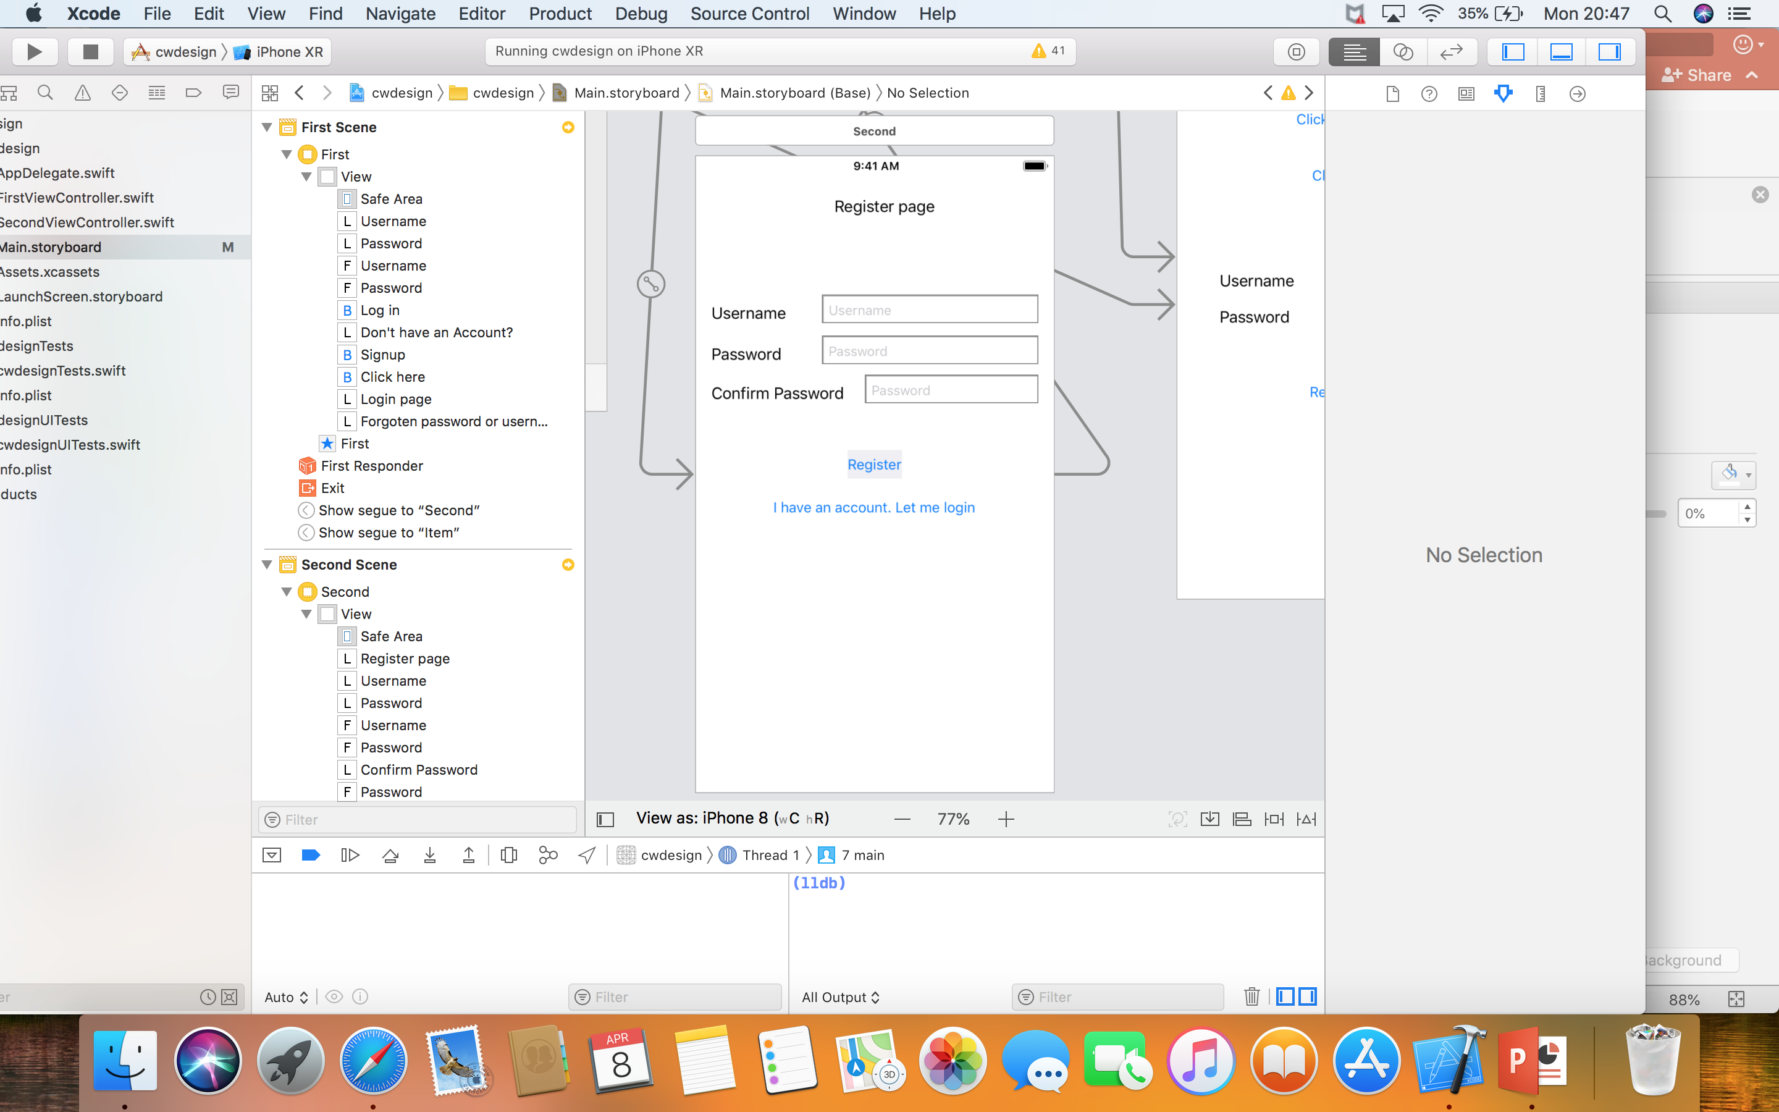
Login and Register Design
A user need to register first in order to login.
Once the user successfully registered their details, the user should be able to login with details.

Slide 5
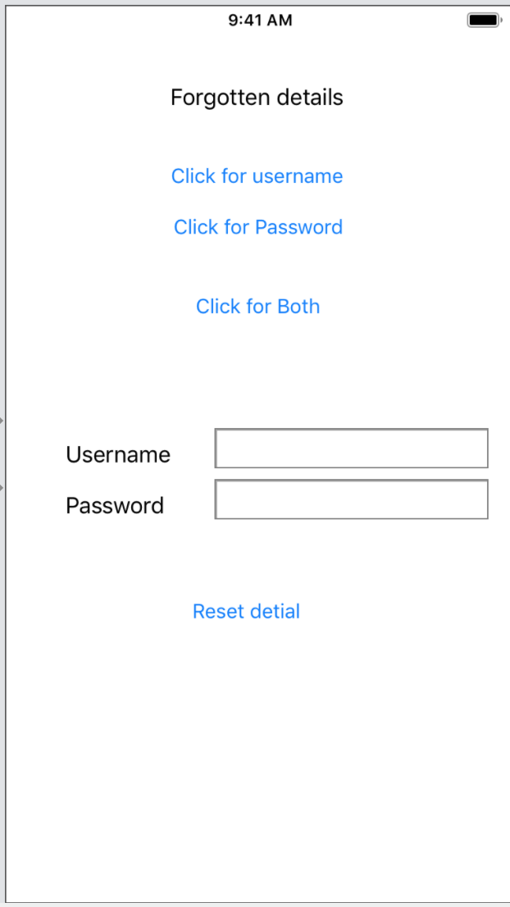
User forgot their details.
An user has an optional to select which user details that they forgot:
They can select “click username button”, if they have forgotten their username.
They can select “click password button”, if they have forgotten their password.
They can select “click for both”, if they have forgotten both of their username and password detail.

Slide 6
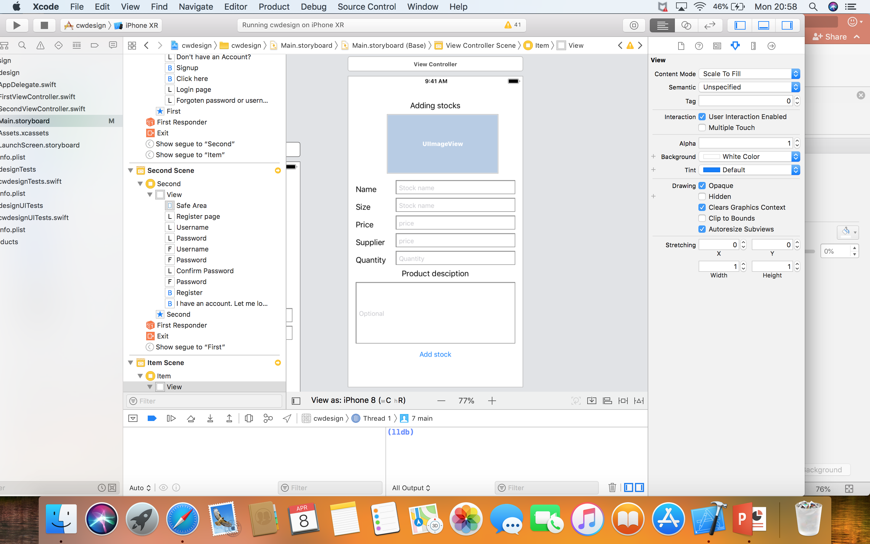
Adding stocks
This is the page where user can add their stock details such as:
A user can upload an image to represent what type of stock is it.
A user can add the stock name.
A user can add the size
A user can add the price
A user can add their supplier name
A user can add the the quantity of the stock
A user has an optional to write about a stock that they wish to.

Slide 7
Team Tasks & Project Plan
As we are 2 members group, it is actually much more easier to follow a mini Agile Methodology.
So far we have 4 meetings (dated and documented in texts) and we have managed to come to a topic that we have agreed on.
We have outlined few key features for the application and have informed the Customer (Mr. Phill) for the approval.

Slide 8
Team Tasks & Project Plan (Continuing)
Project Plan
We have divided tasks into two sections so that both of us can do everything equally.
As it will be a tab based application and we will both write codes for the same tabs and different tabs, we have created a shared GitHub repository taking the advantage of collaborator free feature from GitHub.

Slide 9
Project Analysis (using SWOT)
Strength
Clear core implantation set up goals.
Agile Methodology project track record.
Overall the project is very straightforward.
Weakness
Gaps in knowledge and expertise (2nd iOS app for both of us)
Deadline

Slide 10
Project Analysis(using SWOT continuing)
Opportunities
Market demand for small startups.
New innovations
Changing consumer behavior
Threats
It will be a totally free application, hence no threat assumed.

